Slide 1
URLConnections
Dr.Mohammed Abdalla Mahmoud Youssif
Network Programming
Beni-Suef University - Faculty of Computers and Artificial Intelligence

Slide 2
Overview
URLConnection is an abstract class that represents an active connection to a resource specified by a URL.
It is rare to instantiate URLConnection objects directly in your source code; instead, the runtime environment creates these objects as needed, depending on the protocol in use.
The class (which is unknown at compile time) is then instantiated using the forName() and newInstance() methods of the java.lang.Class class.

Slide 3
Opening URLConnections
A program that uses the URLConnection class directly follows this basic sequence of steps:
1. Construct a URL object.
2. Invoke the URL object’s openConnection() method to retrieve a URLConnection object for that URL.
3. Configure the URLConnection.
4. Read the header fields.
5. Get an input stream and read data.
6. Get an output stream and write data.
7. Close the connection.
Notes:
You don’t always perform all these steps. For instance, if the default setup for a particular kind of URL is acceptable, you can skip step 3. If you only want the data from the server and don’t care about any metainformation, or if the protocol doesn’t provide any met‐ ainformation, you can skip step 4. If you only want to receive data from the server but not send data to the server, you’ll skip step 6. Depending on the protocol, steps 5 and 6 may be reversed or interlaced.

Slide 4
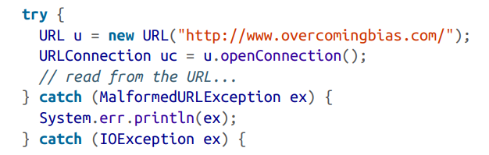
Opening URLConnections
The single constructor for the URLConnection class is protected: protected URLConnection(URL url)
Consequently, unless you’re subclassing URLConnection to handle a new kind of URL (i.e., writing a protocol handler), you create one of these objects by invoking the open Connection() method of the URL class. For example:

Slide 5
Opening URLConnections
The URLConnection class is declared abstract. However, all but one of its methods are implemented.
You may find it convenient or necessary to override other methods in the class; but the single method that subclasses must implement is connect(), which makes a connection to a server and thus depends on the type of service (HTTP, FTP, and so on).
For example, a sun.net.www.protocol.file.FileURLConnection’s connect() method converts the URL to a filename in the appropriate directory, creates MIME information for the file, and then opens a buffered FileInputStream to the file.
The connect() method of sun.net.www.protocol.http.HttpURLConnection creates a sun.net.www.http.HttpClient object, which is responsible for connecting to the server:

Slide 6
Opening URLConnections
public abstract void connect() throws IOException
When a URLConnection is first constructed, it is unconnected; that is, the local and remote host cannot send and receive data.
There is no socket connecting the two hosts.
The connect() method establishes a connection—normally using TCP sockets but possibly through some other mechanism—between the local and remote host so they can send and receive data.
However, getInputStream(), getContent(), getHeader Field(), and other methods that require an open connection will call connect() if the connection isn’t yet open.
Therefore, you rarely need to call connect() directly.

Slide 7
Reading Data from a Server
The following is the minimal set of steps needed to retrieve data from a URL using a URLConnection object:
1. Construct a URL object.
2. Invoke the URL object’s openConnection() method to retrieve a URLConnection object for that URL.
3. Invoke the URLConnection’s getInputStream() method.
4. Read from the input stream using the usual stream API.

Slide 8
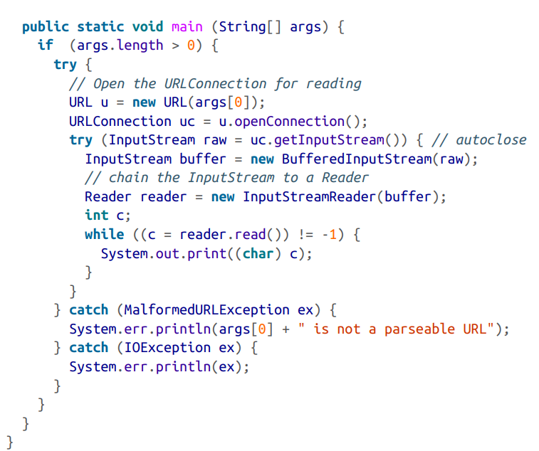
Reading Data from a Server

Slide 9
Reading Data from a Server
The differences between URL and URLConnection aren’t apparent with just a simple input stream as in this example.
The biggest differences between the two classes are:
• URLConnection provides access to the HTTP header.
• URLConnection can configure the request parameters sent to the server.
• URLConnection can write data to the server as well as read data from the server.

Slide 10
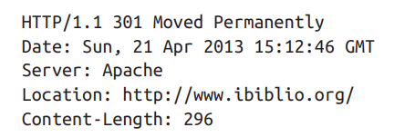

Reading the Header
HTTP servers provide a substantial amount of information in the header that precedes each response. For example, here’s a typical HTTP header returned by an Apache web server:
Notes:
There’s a lot of information there. In general, an HTTP header may include the content type of the requested document, the length of the document in bytes, the character set in which the content is encoded, the date and time, the date the content expires, and the date the content was last modified. However, the information depends on the server; some servers send all this information for each request, others send some information, and a few don’t send anything. The methods of this section allow you to query a URL Connection to find out what metadata the server has provided

Slide 11
Retrieving Specific Header Fields
The first six methods request specific, particularly common fields from the header.
These are:
• Content-type
• Content-length
• Content-encoding
• Date
• Last-modified
• Expires

Slide 12
Retrieving Specific Header Fields (Methods)
public String getContentType()
The getContentType() method returns the MIME media type of the response body.
It relies on the web server to send a valid content type.
It throws no exceptions and returns null if the content type isn’t available.
Other commonly used types include : text/plain, image/gif, application/xml, and image/jpeg.
If the content type is some form of text, this header may also contain a character set part identifying the document’s character encoding. For example: Content-type: text/html; charset=UTF-8

Slide 13
Retrieving Specific Header Fields (Methods)
public int getContentLength()
The getContentLength() method tells you how many bytes there are in the content.
If there is no Content-length header, getContentLength() returns –1.
The method throws no exceptions.
It is used when you need to know exactly how many bytes to read or when you need to create a buffer large enough to hold the data in advance.
As networks get faster and files get bigger, it is actually possible to find resources whose
size exceeds the maximum int value (about 2.1 billion bytes). In this case, getContentLength() returns –1.
Java 7 adds a getContentLengthLong() method that works just like getContentLength() except that it returns a long instead of an int and thus can handle much larger resources: public int getContentLengthLong() // Java 7

Slide 14
Retrieving Specific Header Fields (Methods)
public String getContentEncoding()
The getContentEncoding() method returns a String that tells you how the content is encoded.
If the content is sent unencoded (as is commonly the case with HTTP servers), this method returns null. It throws no exceptions.

Slide 15
Retrieving Specific Header Fields (Methods)
public long getDate()
The getDate() method returns a long that tells you when the document was sent, in
milliseconds since midnight, Greenwich Mean Time (GMT), January 1, 1970.
public long getExpiration()
Some documents have server-based expiration dates that indicate when the document should be deleted from the cache and reloaded from the server.
getExpiration() is very similar to getDate(), differing only in how the return value is interpreted. It returns a long indicating the number of milliseconds after 12:00 A.M., GMT, January 1, 1970, at which the document expires. If the HTTP header does not include an Expiration field,
getExpiration() returns 0, which means that the document does not expire and can remain in the cache indefinitely

Slide 16
Retrieving Specific Header Fields (Methods)
public long getLastModified()
The final date method, getLastModified(), returns the date on which the document was last modified.
Again, the date is given as the number of milliseconds since midnight, GMT, January 1, 1970.
If the HTTP header does not include a Last-modified field (and many don’t), this method returns 0.

Slide 17
Retrieving Arbitrary Header Fields
The last six methods requested specific fields from the header, but there’s no theoretical limit to the number of header fields a message can contain.
The next five methods inspect arbitrary fields in a header.
public String getHeaderField(String name)
The getHeaderField() method returns the value of a named header field. The name of the header is not case sensitive and does not include a closing colon.
Notes:
Arbitrary اعتباطيا

Slide 18
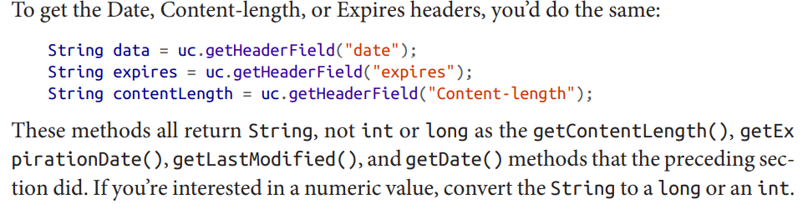
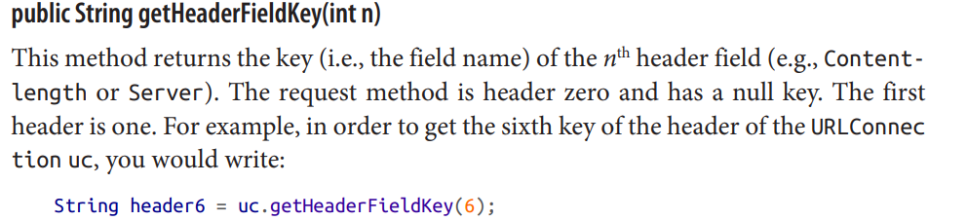
Retrieving Arbitrary Header Fields

Slide 19
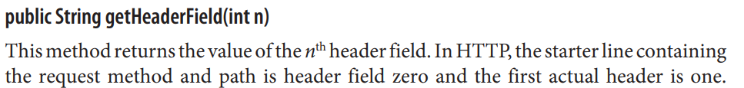
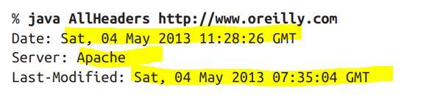
Retrieving Arbitrary Header Fields

Slide 20
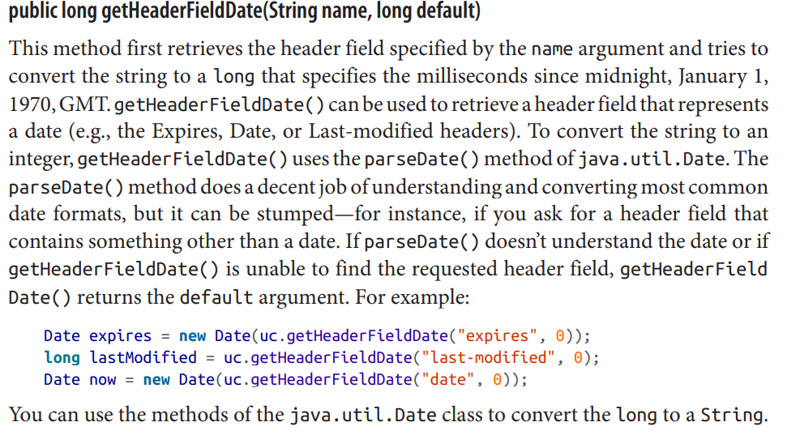
Retrieving Arbitrary Header Fields

Slide 21
Caches
Web browsers have been caching pages and images for years.
If a logo is repeated on every page of a site, the browser normally loads it from the remote server only once, stores it in its cache, and reloads it from the cache whenever it’s needed rather than requesting it from the remote server every time the logo is encountered.
Several HTTP headers, including Expires and Cache-control, can control caching.
By default, the assumption is that a page accessed with GET over HTTP can and should be cached.
A page accessed with HTTPS or POST usually shouldn’t be. However, HTTP headers can adjust this:

Slide 22
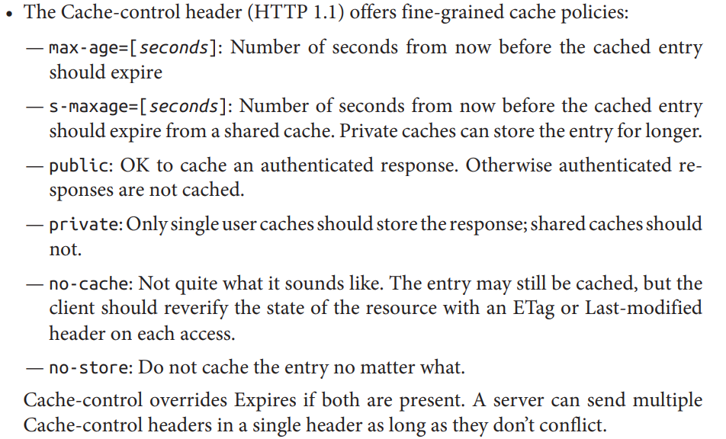
Caches
Notes:
fine grained بالغة الدقة

Slide 23
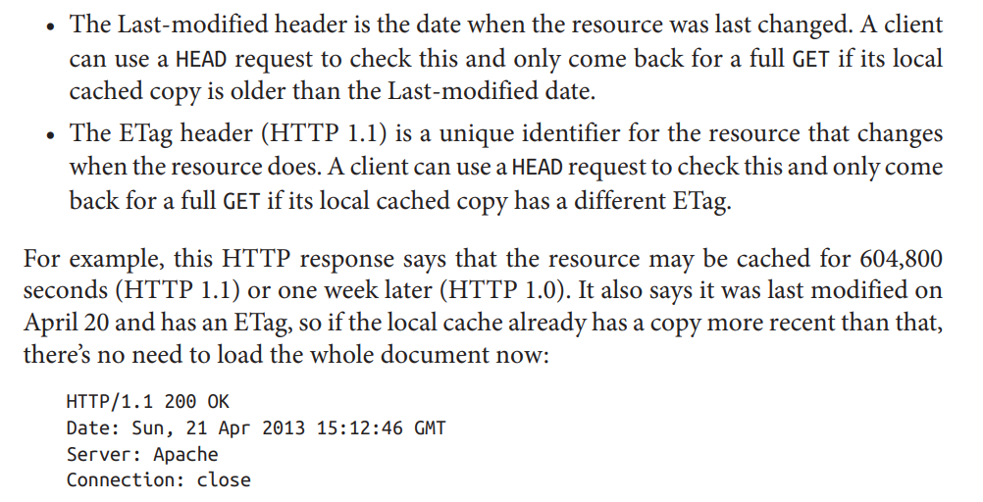
Caches
Notes:
A client can take advantage of this information:
• If a representation of the resource is available in the local cache, and its expiry date has not arrived, just use it. Don’t even bother talking to the server.
• If a representation of the resource is available in the local cache, but the expiry date has arrived, check the server with HEAD to see if the resource has changed before performing a full GET.

Slide 24
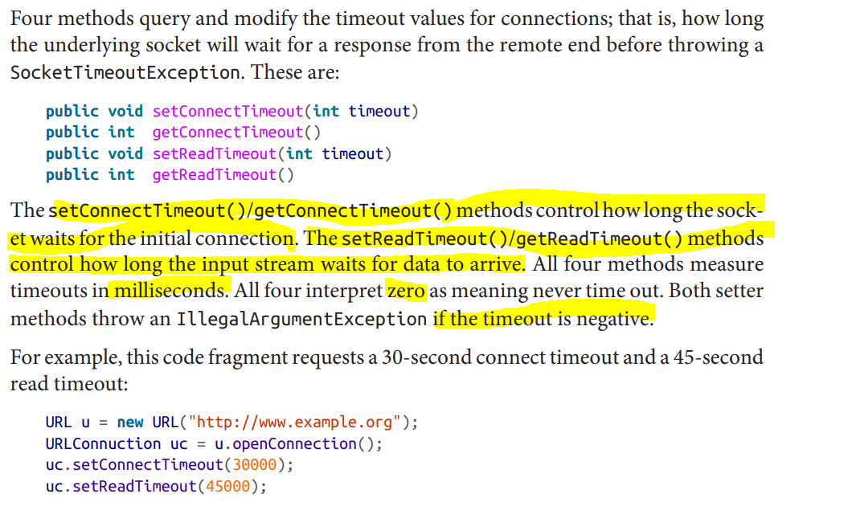
Timeouts

Slide 25
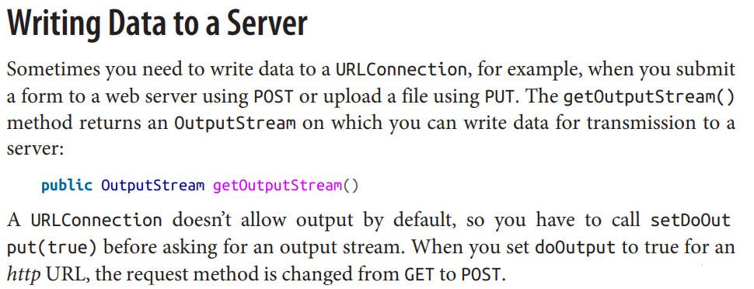
Writing Data to a Server
However, GET should be limited to safe operations, such as search requests or page navigation, and not used for unsafe operations that create or modify a resource, such as posting a comment on a web page or ordering a pizza. Safe operations can be bookmarked, cached, spidered, prefetched, and so on. Unsafe operations should not be
Once you have an OutputStream, buffer it by chaining it to a BufferedOutputStream or a BufferedWriter. You may also chain it to a DataOutputStream, an OutputStream Writer, or some other class that’s more convenient to use than a raw OutputStream.

Slide 26
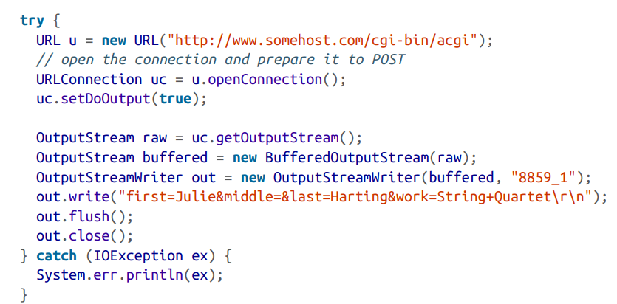
Writing Data to a Server
The post() method actually sends the data to the server by opening a URLConnection to the specified URL, setting its doOutput field to true, and writing the query string on the output stream. It then returns the input stream containing the server’s response.

Slide 27
Writing Data to a Server
To summarize, posting data to a form requires these steps:
Decide what name-value pairs you’ll send to the server-side program.
Write the server-side program that will accept and process the request. If it doesn’t use any custom data encoding, you can test this program using a regular HTML form and a web browser.
Create a query string in your Java program. The string should look like this: name1=value1&name2=value2&name3=value3
Pass each name and value in the query string to URLEncoder.encode() before adding it to the query string.
4. Open a URLConnection to the URL of the program that will accept the data.
5. Set doOutput to true by invoking setDoOutput(true).
6. Write the query string onto the URLConnection’s OutputStream.
7. Close the URLConnection’s OutputStream.
8. Read the server response from the URLConnection’s InputStream.

Slide 28
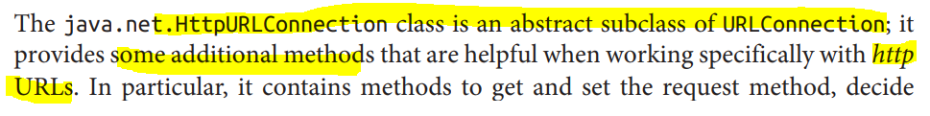
HttpURLConnection

Slide 29
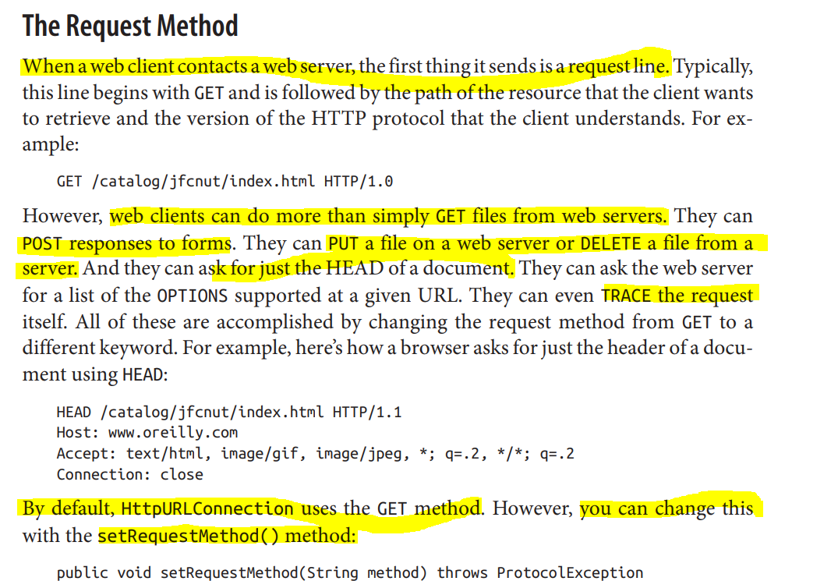
HttpURLConnection
Notes:
The method argument should be one of these seven case-sensitive strings:
• GET • POST • HEAD • PUT • DELETE • OPTIONS • TRACE

Slide 30
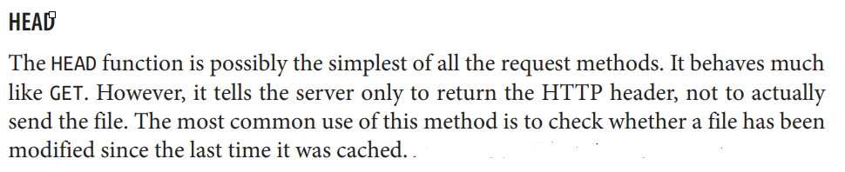
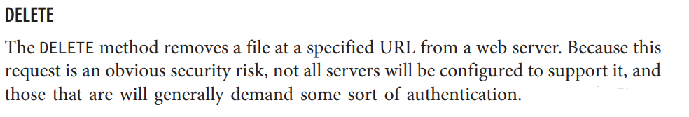
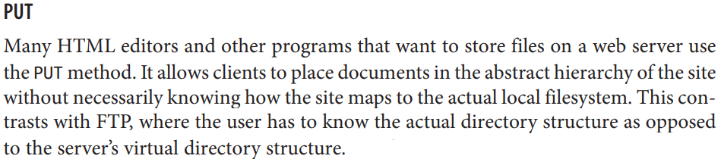
HttpURLConnection

Slide 31
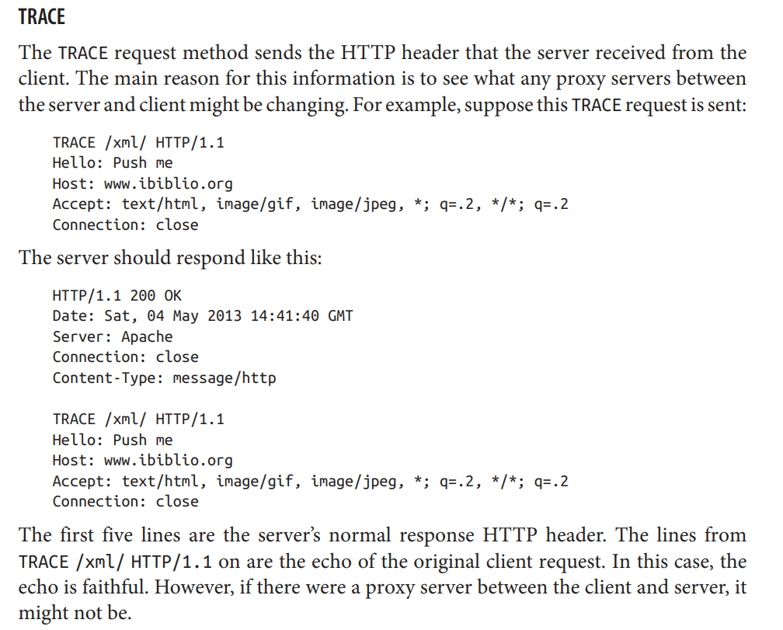
HttpURLConnection

Slide 32
Disconnecting from the Server
HTTP 1.1 supports persistent connections that allow multiple requests and responses to be sent over a single TCP socket. However, when Keep-Alive is used, the server won’t immediately close a connection simply because it has sent the last byte of data to the client.
The client may, after all, send another request. Servers will time out and close the connection in as little as 5 seconds of inactivity. However, it’s still preferred for the client to close the connection as soon as it knows it’s done.
The HttpURLConnection class transparently supports HTTP Keep-Alive unless you explicitly turn it off.
That is, it will reuse sockets if you connect to the same server again before the server has closed the connection.
Once you know you’re done talking to a particular host, the disconnect() method enables a client to break the connection: public abstract void disconnect()
If any streams are still open on this connection, disconnect() closes them. However, the reverse is not true. Closing a stream on a persistent connection does not close the socket and disconnect.

